Slide 1
Preesented By Subhajit Barh
Roll- 18MA60R33
Dept:-Mathematics
(CSDP)
Linux Kernel Exploits
CVE-2016-5195
Presented By
Subhajit Barh
Roll-18MA60R33
Dept:-Mathematics
IIT KHARAGPUR

Slide 2

(CVE-2016-5195)
Linux Kernel Exploit

Slide 3
Possible Questions
What is Dirty Cow?
What is with the weird Name?
What is a Kernel??
What is Privilage Escalation?
What is its impact??
And So on .......

Slide 4
What is Dirty COW
Dirty COW is a Critical(Priv-Esc Type) Security Vulnerability which was present in Linux Kernel.
It was there since kernel version 2.6.22 (released in September 2007)
It was exploited in October 2016
The vulnerability has been patched in Linux kernel versions 4.8.3, 4.7.9, 4.4.26 and newer.
The patch produced in 2016 did not fully address the issue and a revised patch was released on November 27, 2017, before public dissemination of the vulnerability.

Slide 5
Which Means ...
Operating Systems Like
Ubuntu 14.04,12.04,16.10 and Lower
RHEL 7, CentOS 7 RHEL 7, CentOS 7 and lower
And othe Linux Distros which used or still uses those kernels are vulnerable.
That list is quite large.

Slide 6
Outline
What is Privilage Escalation
Linux Permission System
Linux Kernel
Paging and Page Fault
Copy on Write
Dirty Bits
etc.....

Slide 7
Disclaimer and Prerequisite

Slide 8
What is privilage Escalation
Privilege escalation is the act of exploiting a bug, design flaw or configuration oversight in an operating system or software application to gain elevated access to resources that are normally protected from an application or user. The result is that an application with more privileges than intended by the application developer or system administrator can perform unauthorized actions.
--Wikipidia

Slide 9
Our Aim .....
To Write in Write Protected Files ....
To become ROOT

Slide 10
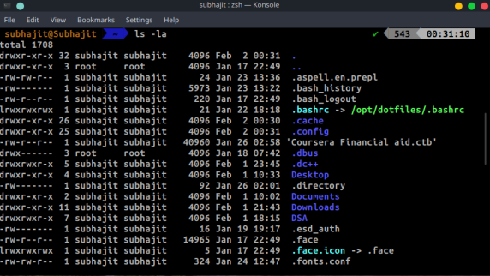
Linux Permission System
-rw-r—r--,
Drwxr-xr-x
10 charecters
‘-’ if its file and d if it is directory
Next 3 letters are permission for owner
‘r’ means read privilage
‘w’ means write privilage
‘x’ means execution privilage
Next 3 letters are for groups(same description)
Next 3 are for others
Owner
Group
Permission

Slide 11
Continued .......
‘-’ means absent of permission
If ‘-’ is there in place of w that means it is write protected
‘root’ - is the Highest privilage in linux .
Root has all the permissions that is read write and execute .
We want to become root from normal users ....
Is that possible ?
There is a command called sudo (Superuser Do) whitch grants you temporary root privilage if you(user) are listeted in sudoers(/etc/sudoers) file
What if you are not in sudoers file ?? can you gain root privilage ??
Normally you can’t .......
But you can take advantage of security loop-holes and escalate your privilage.
That is called privilage escatation attack.
There are many Priv-Esc methedologies .
One of them is exploiting Kernel .
It is Dengerous and unstable .
But can grant you root privilage
They are Called Kernel Exploits .
Dirty Cow is an Kernel Exploit.

Slide 12
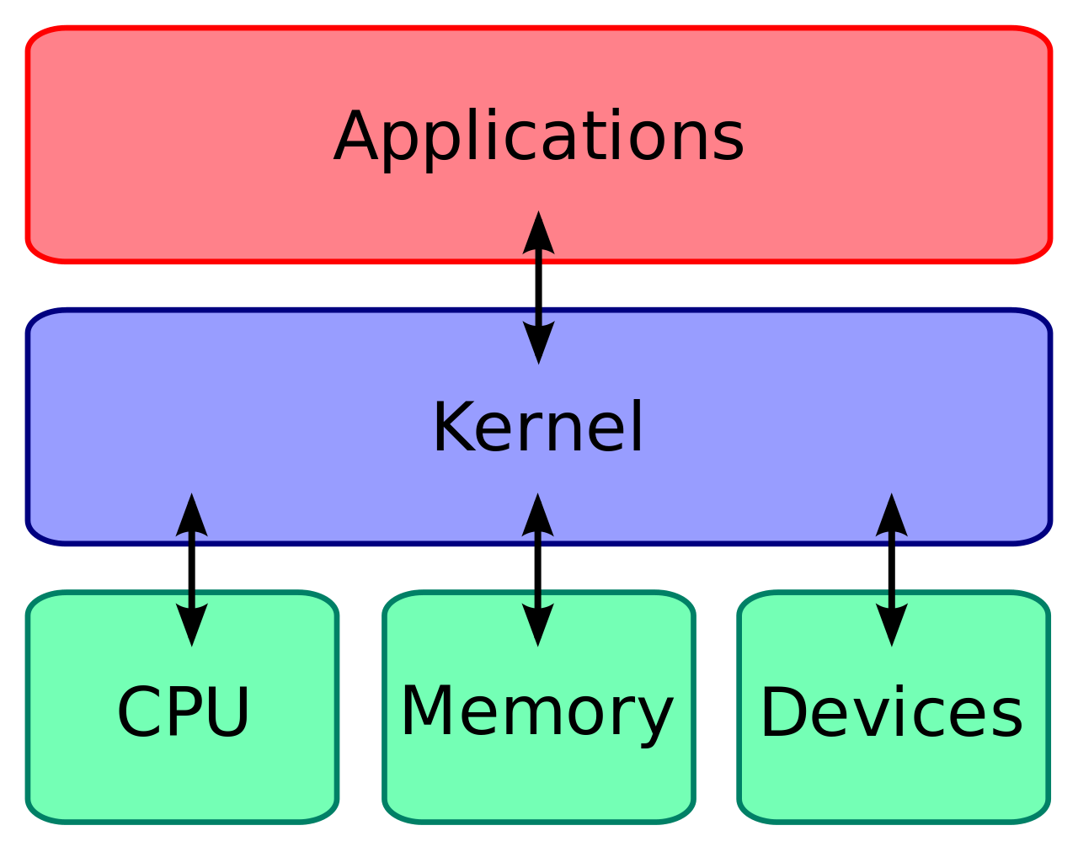
Linux Kernel

Slide 13

Linux Kernel

Slide 14
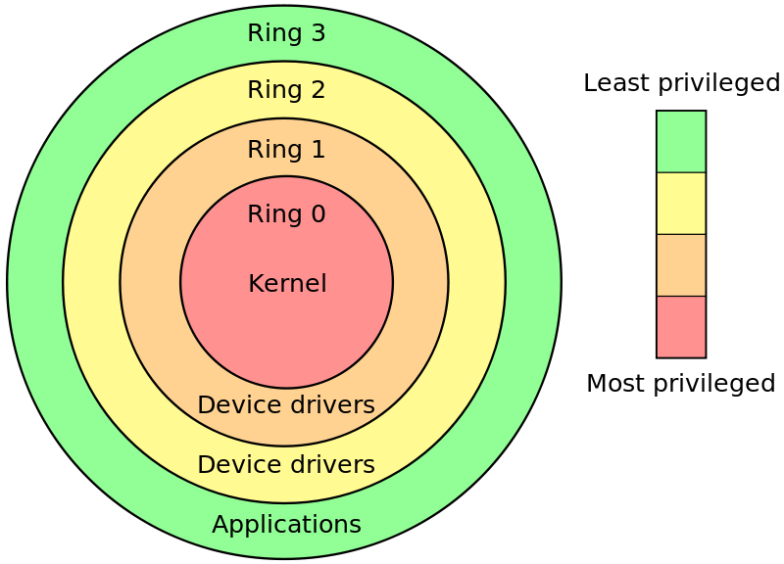
Linux Kernel

Slide 15
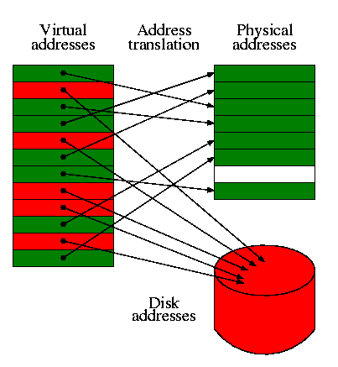
Paging
Paging is a memory management scheme that eliminates the need for contiguous allocation of physical memory. This scheme permits the physical address space of a process to be non – contiguous.

Slide 16
Page Fault
What happens when cpu can not find a physical memory page corresponding to vertual memory?
May be the memory have been swaped to secondary storage ....
MMU can not find the associated page in page table ...
It initiates a page fault trap interrupt .
The page fault handler in the operating system makes an entry for the page in the page table and hands the control to the MMU .
Page Fault can be Hard Fault or Soft Fault .
Soft faults are Common and happens when page is present in the physical memory but just there is no entry in page table for that. CPU finds that memory and and makes entry in page table and hands over control to the main process .
Hard fault is when page has ben swapped in the Hard Disk and cpu need to fetch it from the hard disk to main memory . As Hard Disk is slow it reduces the performance and this phenomenon is called thrashing.

Slide 17
Copy On Write(CoW)
When want to write on any file which is now mapped to the memory Kernel creates a copy of it and writes on it But if the file is write protected then cpu wo’nt write in the changes in the hard disk but raises an exception (Permission Denied) .
It is done by using some flags one of them is foll_write(importent one for this presentation).
If file is not write protected then foll_write is not set and cpu writes the changes to the original disk.
What happen when CPU initates a COW page but does not find it .
Definately a fage fault happens and the vulnerability lies in how kernel resolves the fault.
But How we force the page fault in that exact time ?
We will See .......

Slide 18
Code

Slide 19
Code ...

Slide 20
Threading

Slide 21
Code

Slide 22
Code...

Slide 23
Code ...

Slide 24
Demo ...

Slide 25
Demo ....

Slide 26
Conclusion

Slide 27
Conclusion ....

Slide 28
References ...

Slide 29
Questions ???

